Slide 1


Red Hat Certified System Administration (RHCSA)
azaj.ikbal

Slide 2
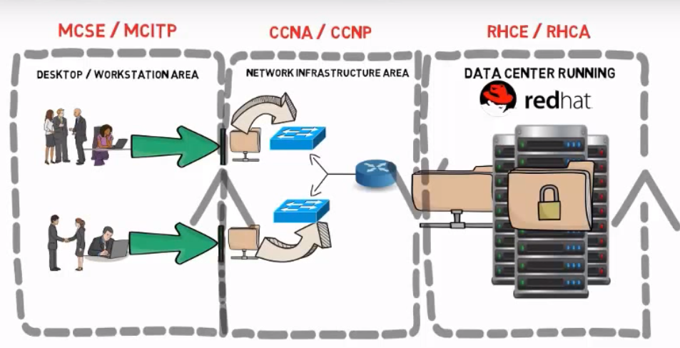
About This Course

Slide 3
What We Cover in This Course - 1
Lesson 01: Introduction to Linux & UNIX
Lesson 02: Getting started with Linux
Lesson 03: Linux Text Processing Tools
Lesson 04: Linux Text Editor vim
Lesson 05: User and Group administration
Lesson 06: Linux File Permission and Umask
Lesson 07: Linux Advanced File Permission (ACL)
Lesson 08: Linux Compression Utilities
Lesson 09: Linux Process Management
Lesson 10: Linux File System Management
Lesson 11: Swap Partition Management
Lesson 12: Logical Volume Management (LVM)
Lesson 13: Working with Linux Services and Daemons
Lesson 14: Linux Network Management
Lesson 15: Working with Linux SELinux Security

Slide 4

What We Cover in This Course - 2
Lesson 16: Linux Package Management
Lesson 17: Linux Job Scheduling with at and Crond
Lesson 18: Linux YUM Server Configure
Lesson 19: Linux Virtualized Systems
Lesson 20: NTP Server and Client
Lesson 21: Using Identity Management System (LDAP)

Slide 5
Who Is This Course For ?
RHCSA Exam Candidate
Linux Newbie User
Software Developer
System Administrators

Slide 6
What You Should Know ?
Basic Computer Hardware & Networking
Basic Understanding of Computer Operating Systems
Basic TCP/IP Concept
Basic Internet
Navigation Skills

Slide 7
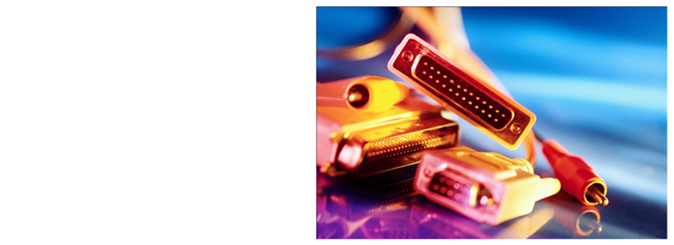
Why Build a Lab ?
Learn Linux, first Hand
Prove that it works for your company’s applications
Prepare for vendor certification
Become an Instructor

Slide 8
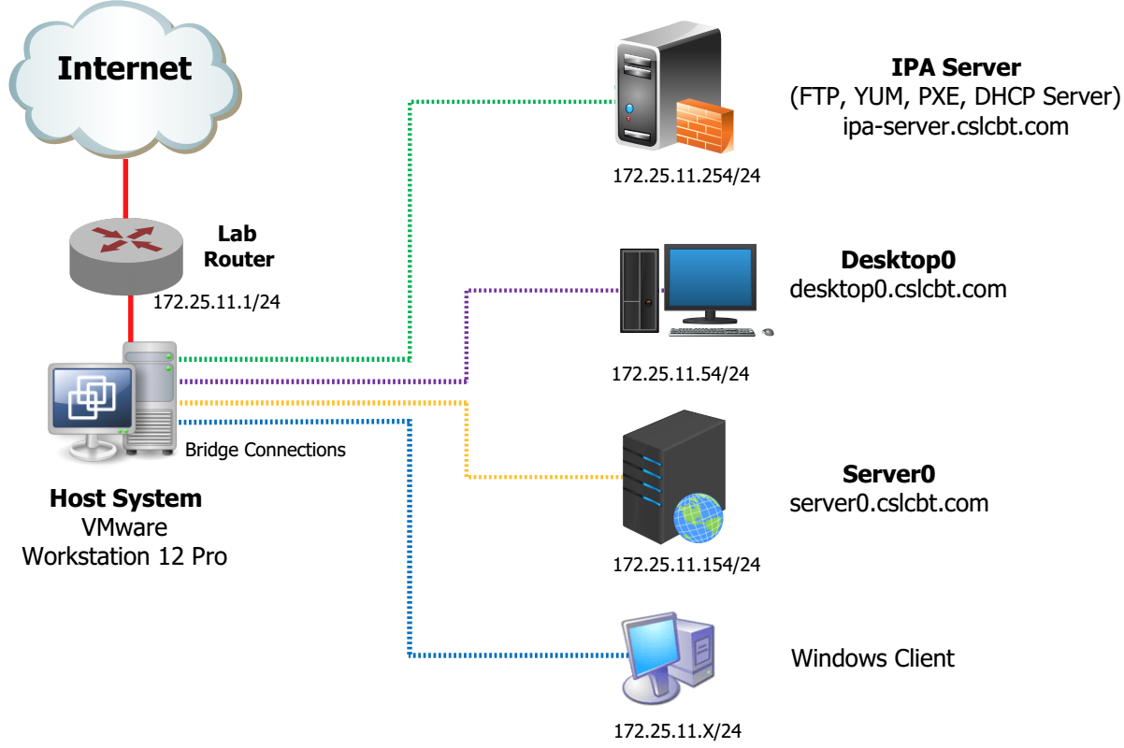
Lab Diagram

Slide 9

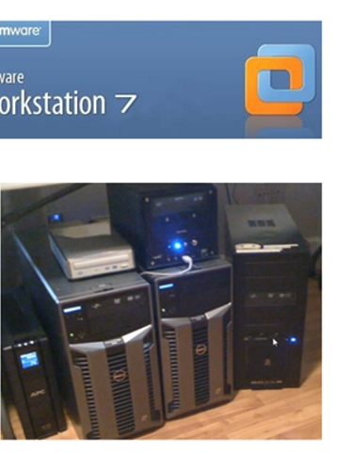
Two Ways to Build a RHCSA Lab
Virtual RHCSA Lab
Physical RHCSA Lab

Slide 10
RHCSA Exam Information
18-21 Questions
Fully Lab Based Offline Exam
Exam Duration – 2.5 Hrs
300 Marks
70% pass marks

Slide 11

Learning Materials
youtube.com/cslcbt
tube.csltraining.com
blog.csltraining.com

Slide 12

Questions, Comments, Concerns ?
/groups/csltraining

Slide 13
Thank you

